Slide 1



October 6th 2010 Tornado Outbreak
By: Paige Swenson
Mentor: Dr. Curtis James
2019 Arizona Space Grant Symposium |Tempe Double Tree Hotel
April 13th 2019

Slide 2


Overview
Motivation
Objectives
Methodology
Results
Conclusion

Slide 3

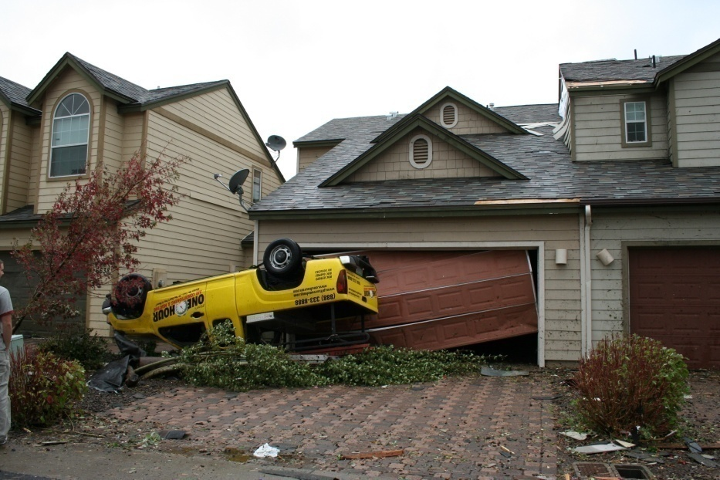
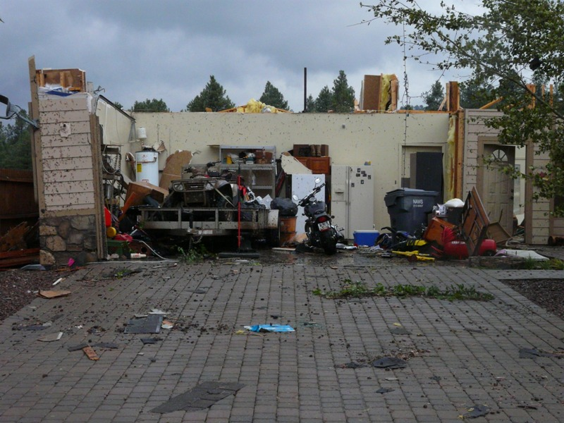
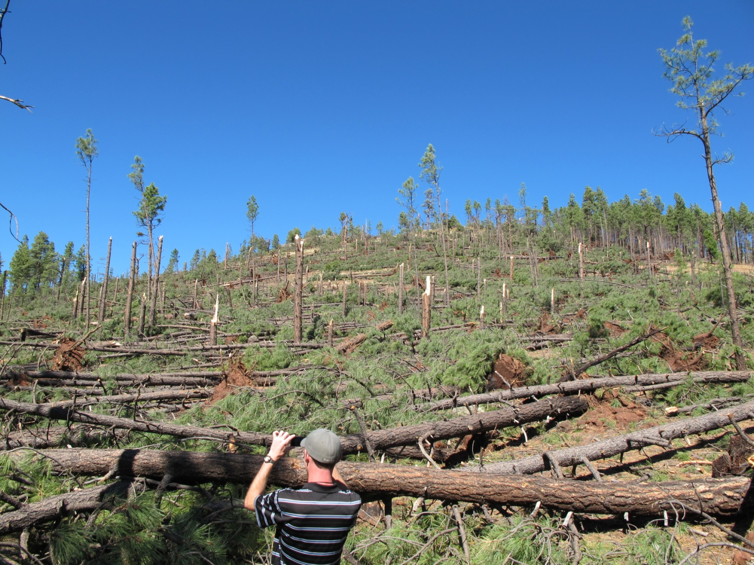
Motivation
Largest tornado outbreak west of Continental Divide
11 confirmed tornadoes
Rare event that is not well understood by forecasters and needs to be documented
Evidence of strong topographic influences
Source: Klimowski, 2010

Slide 4


Objectives
Explore the physical mechanisms that contributed to the event in terms of:
synoptic-scale storm environment
the topographic influences leading to tornadic development

Slide 5


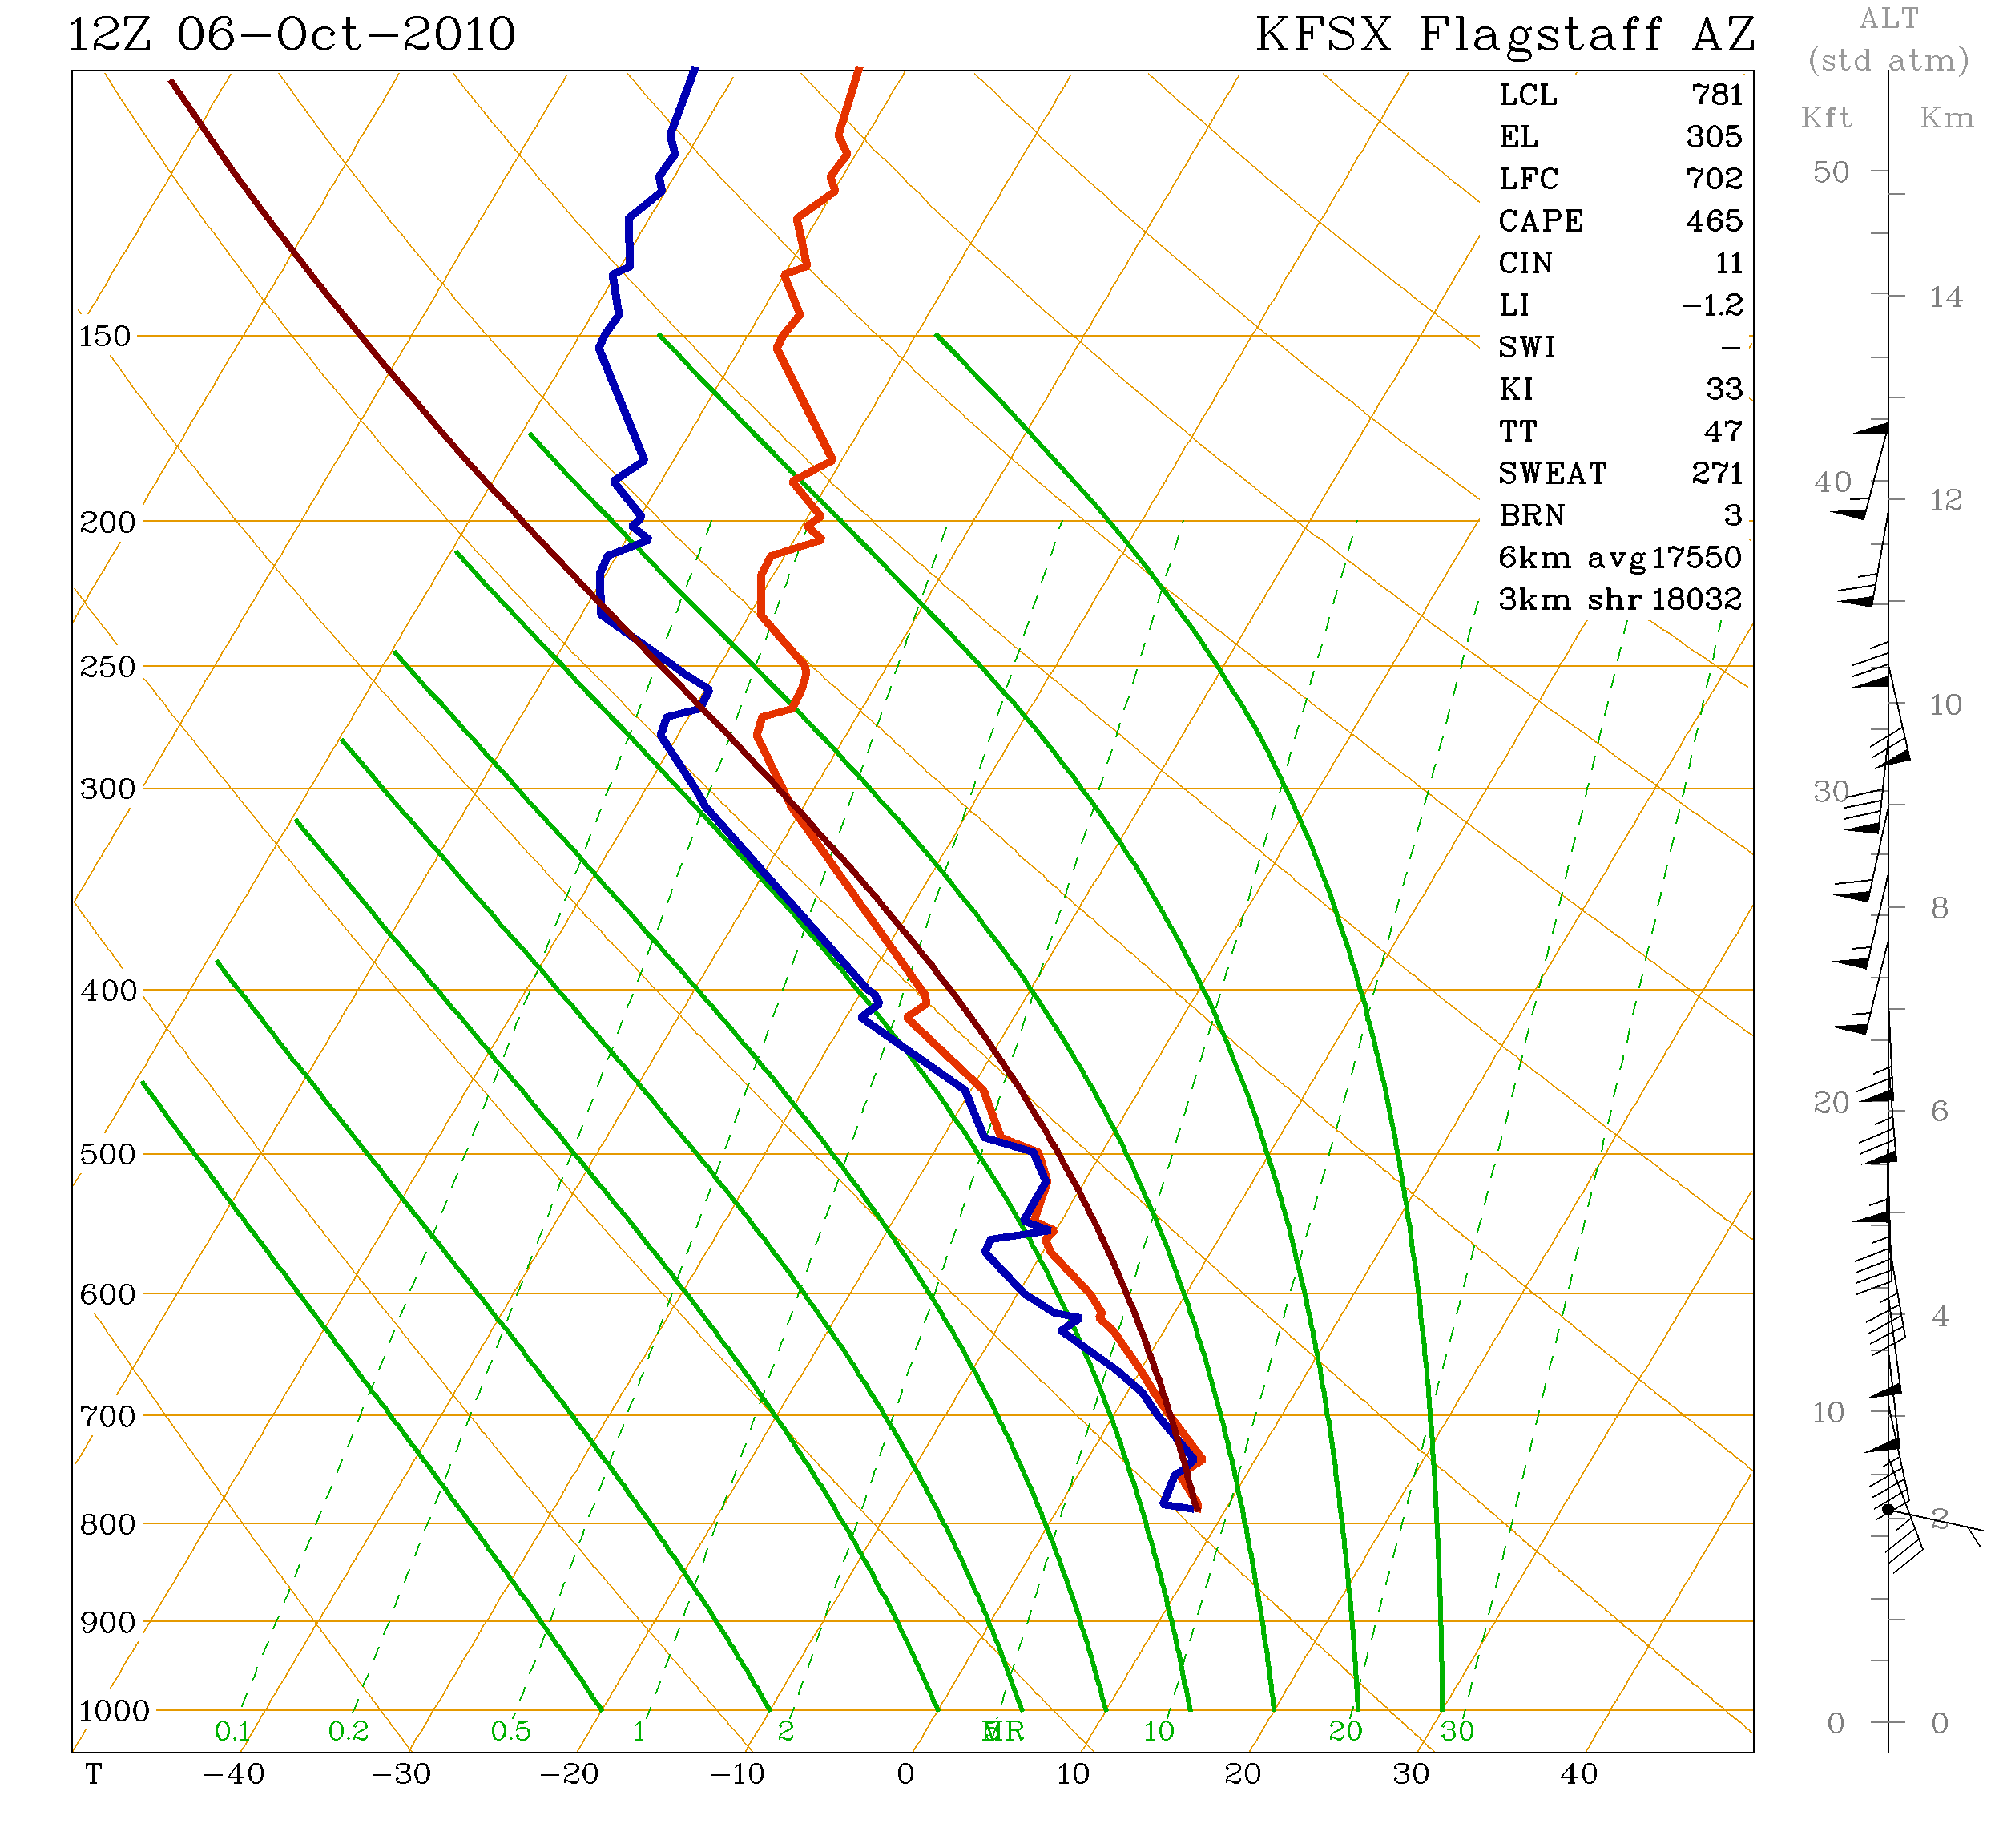
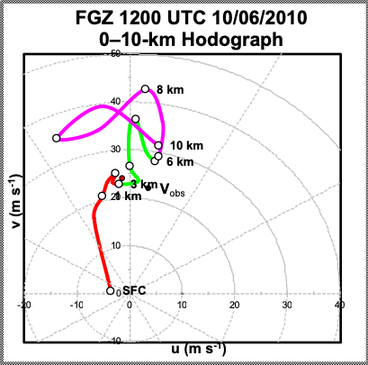
The observed sounding data was from KFSX on 6 Oct 2010 at 12 UTC.
The hodograph was created using the Flagstaff sounding (KFSX)(Klimowski, 2010).

Slide 6


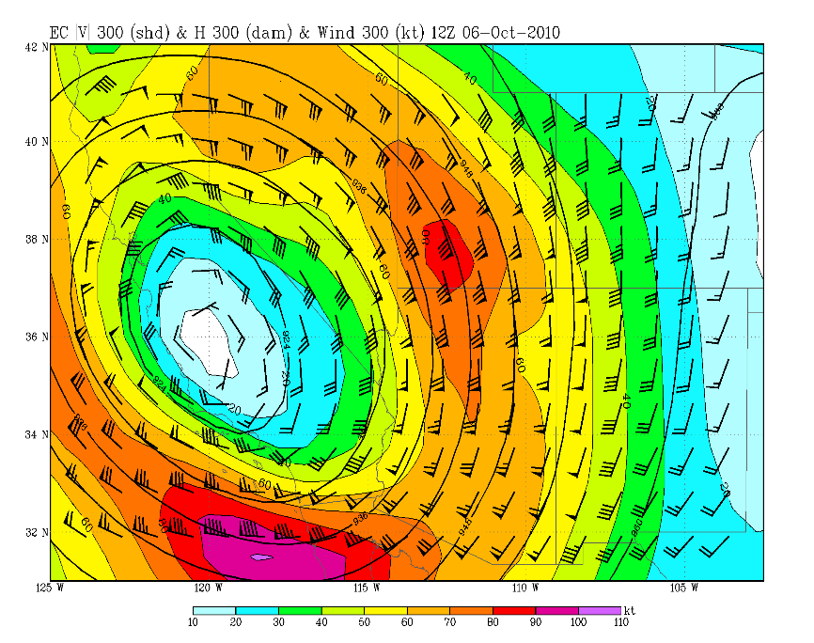
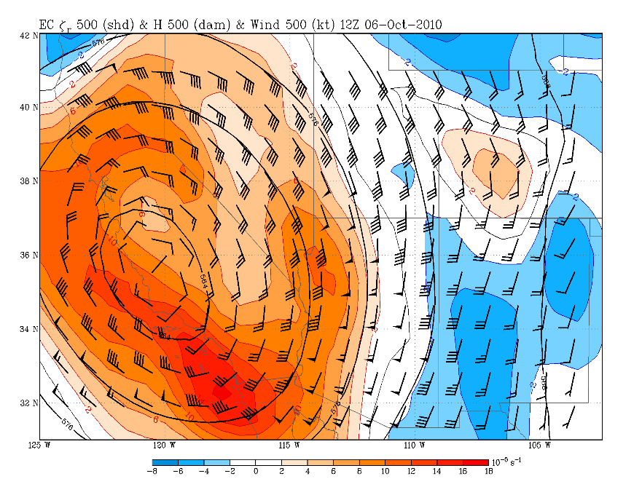
ERA Interim ECMWF reanalysis grids at .75° resolution
The model fields above indicate the presence of a divergent entrance region of an upper jet core ahead of a closed low with vorticity advection and a moist southeasterly low-level jet over northern Arizona. Conditions were ripe for a shallow right- moving supercells.

Slide 7


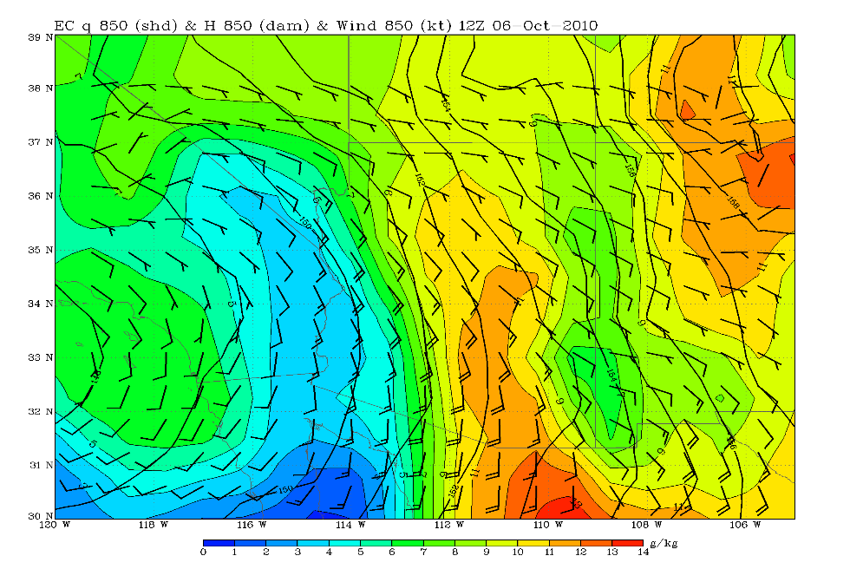
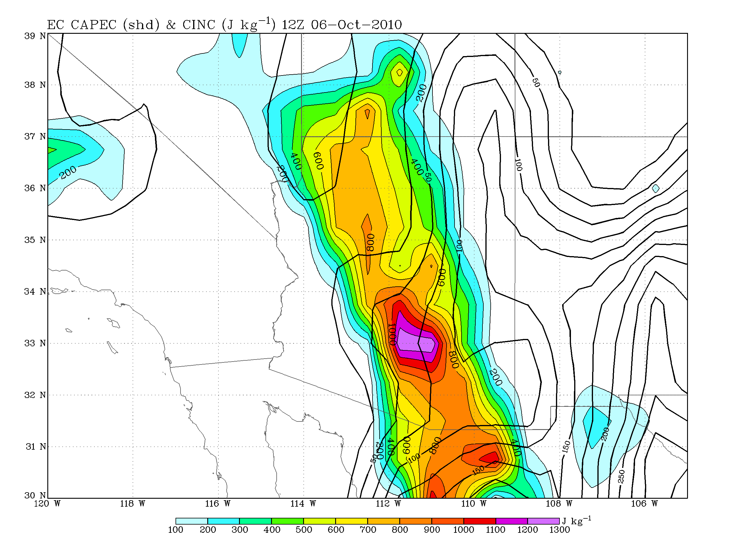
ERA Interim ECMWF reanalysis grids at .75° resolution
The model fields above indicate the presence of low-level southerly winds and a very moist and weakly unstable atmosphere.

Slide 8


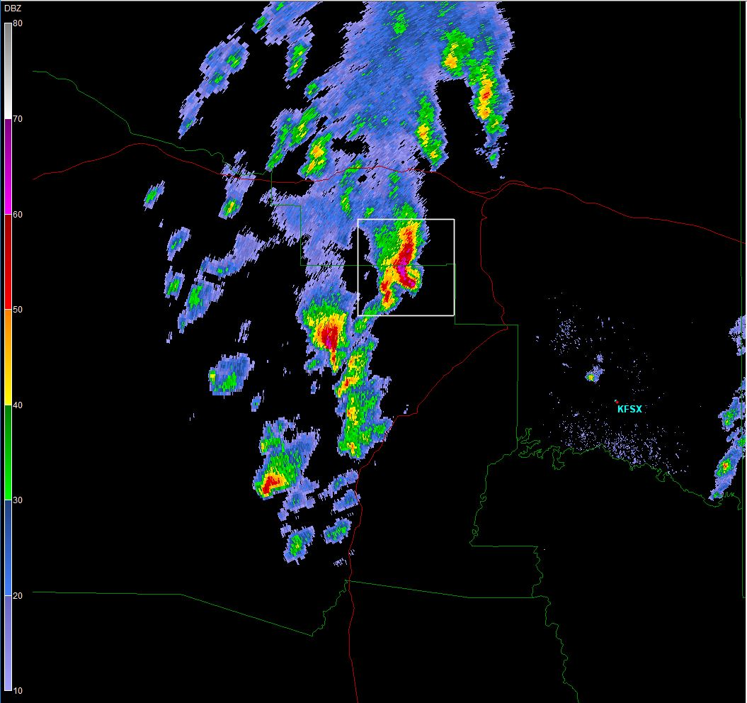
Methodology
Collected full-volume Level II NEXRAD radar volume archives for 6 October 2010
Analyzed them using GR2-Analyst (Source: NCDC)
Cell tracking: Convective cells were tracked if they (1) lasted at least 30 minutes and (2) exhibited a base reflectivity of at least 50 dBZ.
GR2-Analyst 2-D 0.5° PPI plot depicting tornadic supercells

Slide 9


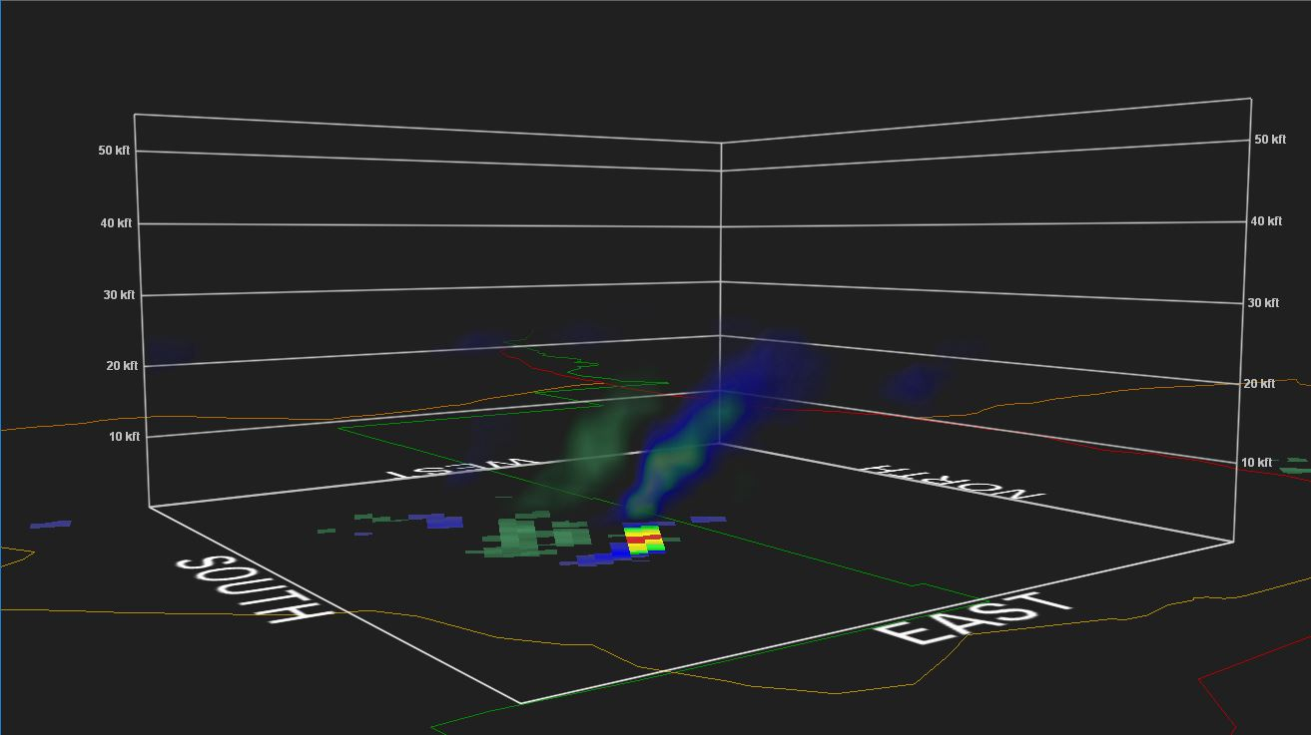
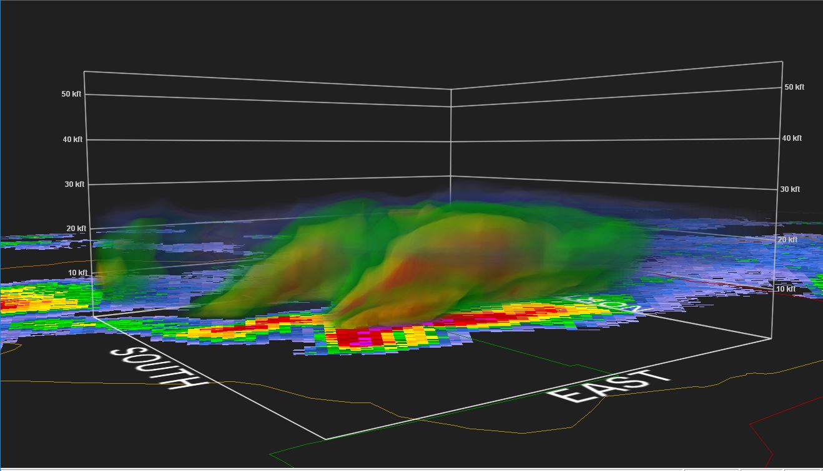
3-D radar depiction
Representation of one storm that produced up to EF-3 tornado damage
Top image displays the NROT(normalized rotation) field.
Bottom image is a display of the base reflectivity.
The supercells exhibited echo tops below 35,000’ MSL and were strongly tilted with height, propagating rapidly towards the north-northeast.
Gr2-Analyst software displaying NROT and Base Reflectivity

Slide 10


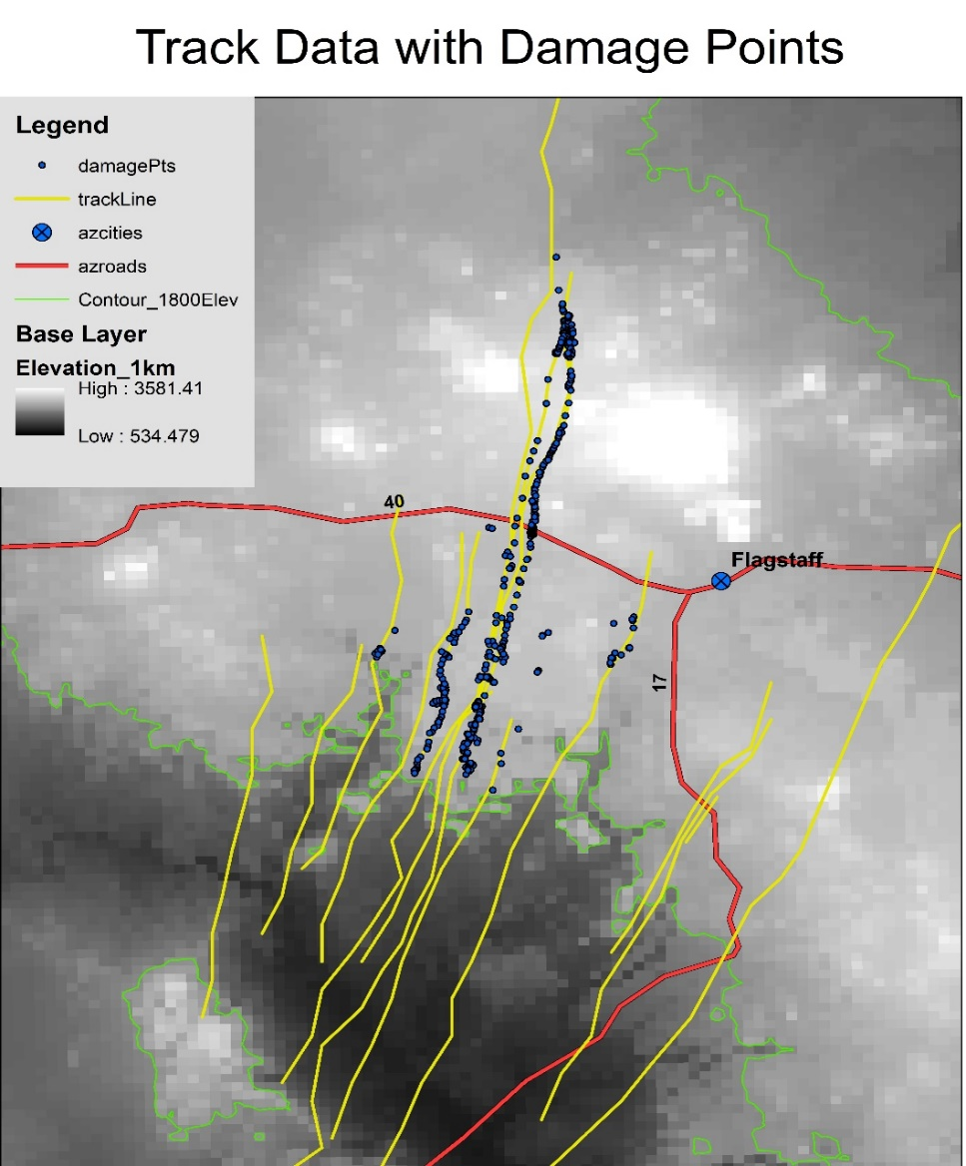
Methodology
Imported collected cell locations into ArcGIS, including latitude, longitude and normalized rotation rate (NROT) data collected at 5-minute intervals for each cell that met the cell tracking criteria.
NROT normalizes the range dependence of the rotation rate calculated using Doppler winds
Created various maps to examine the influences of terrain elevation and slope on the development of rotation in each cell.
Source: NWS (Klimowski 2010)

Slide 11


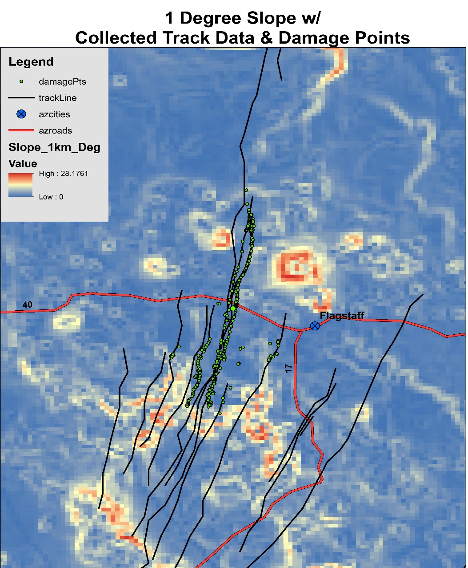
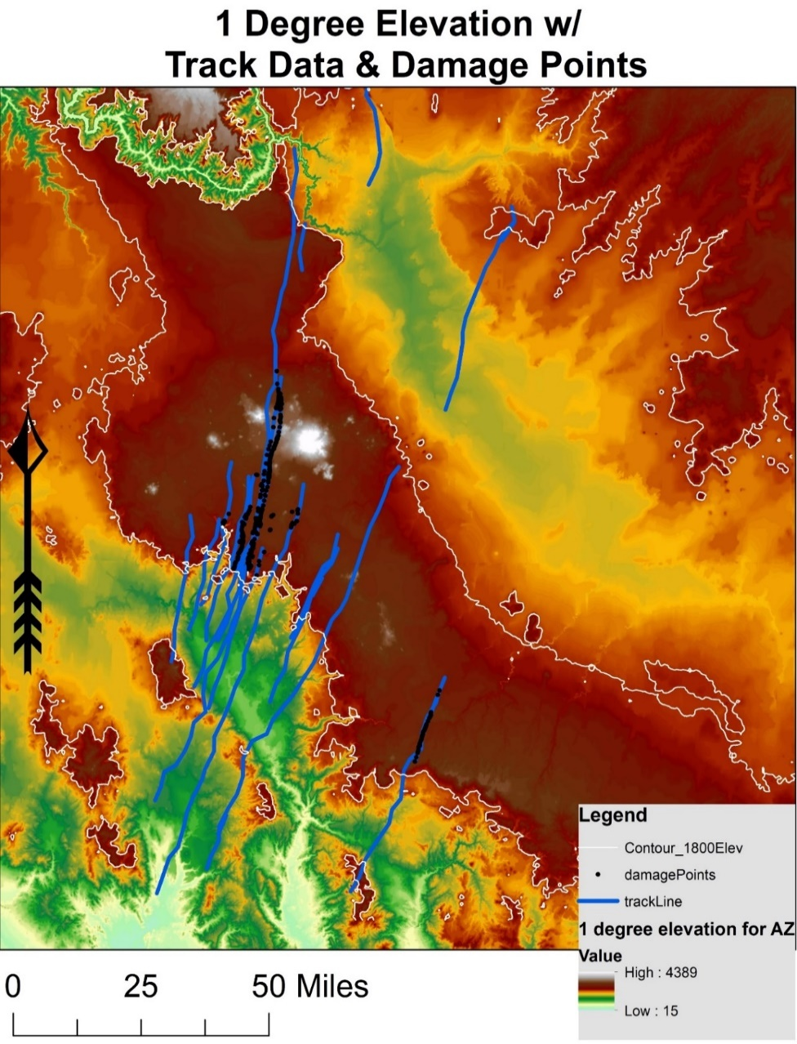
Results
The cell rotation began south of the Mogollon Rim but did not produce any indicated damage until after passing north of this terrain feature.
This happened for not just one cell, but all the shallow supercells that took place in this particular outbreak.
These maps suggest that the terrain had a strong impact on tornado formation.
Radar-derived rotational tracks overlaid w/ tornado damage points from NWS Flagstaff.

Slide 12

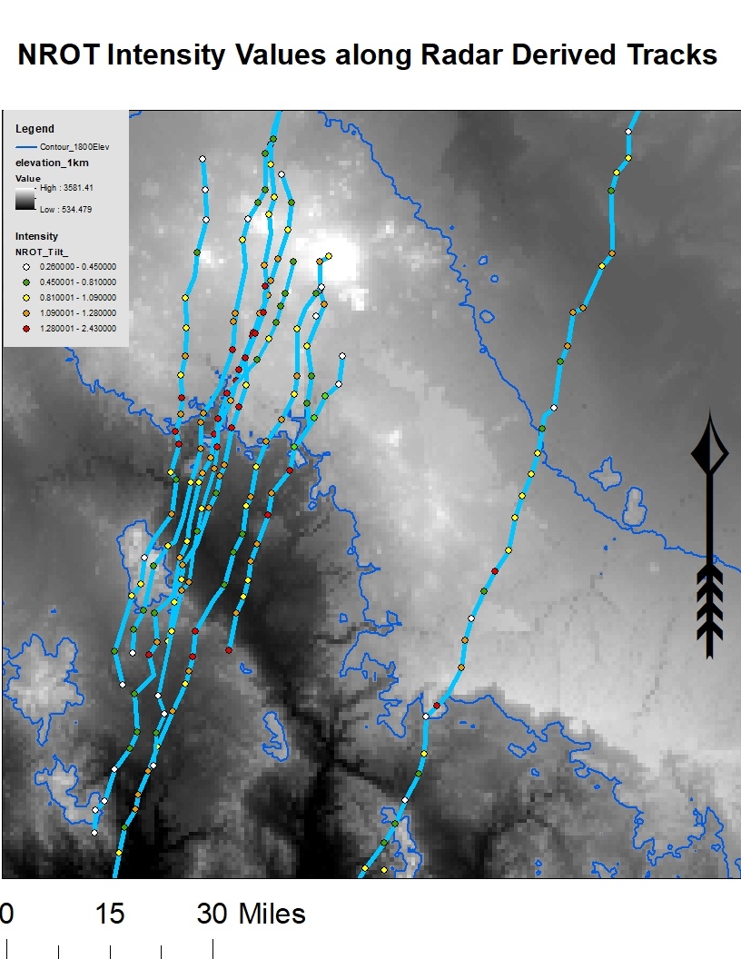
Results
The colored points show the locations of the maximum cyclonic NROT values contained in each 5-min base scan of the radar along all echo tracks that exhibited a meso or TVS signature.
Majority of stronger (red or orange) NROT values were observed over high terrain or where the terrain had recently ascended into higher terrain.
Note, however, that topography was not the only influence creating strong rotational fields (but no tornado damage reports south of the rim)
Radar-derived tracks and NROT intensity values

Slide 13

Conclusions/Future Work
Divergence aloft associated with a jet core ahead of a cut-off low, orographic lifting, a low-level jet, deep saturation, low CAPE and CIN, and strong, deep clockwise shear all evidently favored the formation of this historic outbreak of tornadic supercell thunderstorms.
This event was characterized by a line of shallow fast-moving supercellular thunderstorms that developed on the southwest side of the Mogollon Rim and propagated north north-eastward up and over the rim.
This study indicates that there is strong correlation between topographic elevation or slope and storm rotation.
The dataset created by this research will enable future research into the correlations between elevation and slope and the influences of terrain on tornado development.

Slide 14
Acknowledgments
I would like to express my thanks to the following entities:
Dr. Curtis James for being my research advisor, mentor, chairman, and meteorology professor
Dr. Brian Klimowski (MIC at NWSFO in Flagstaff, AZ) for providing event images and assistance throughout the project
Professor Karen Blevins for improving my knowledge and helping to prepare geophysical data for display in ArcGIS
The NASA Space Grant program at Embry-Riddle for funding this research opportunity

Slide 15
Questions?

